Slide 1
Front End Engineering-I Project
Team Details:
(GROUP-23A, CSE 3rd SEMESTER)
-HARLEEN KAUR, 2310992006
Faculty Coordinator: SHIVAM SINGH
:
Chitkara University Institute of Engineering and Technology,
Chitkara University, Punjab

Slide 2
Table of Contents
Introduction
Problem Statement
Technical Details
Key Features
Project Highlights
Results
Conclusion
References/Links used

Slide 3
Introduction
The title of my project on Animal Shelter is “HelpingHands”: An Animal Shelter is a facility dedicated to the care, rehabilitation, and rehoming of homeless, abandoned, or stray animals, primarily dogs and cats.
Led by an exceptional individual:
-Harleen Kaur my project addresses the need for a digital presence that effectively connects the shelter with the community.
The purpose of the “HelpingHands” project is to develop a comprehensive and user-friendly online platform to support the mission of animal shelters in facilitating pet adoptions, attracting donations, and promoting the purchase of grooming and pet supplies.
The main goals of the project include: User-Friendly Interface, Facilitate Pet Adoptions, Promote the Sale of Grooming and Pet Supplies and Attract Donations.

Slide 4
Problem Statement
Animal shelters often face significant challenges as they follow traditional methods of operation and outreach may not be sufficient to meet the growing needs as they face a variety of complex challenges like Low Adoption Rates, Lack of Community Engagement, Inefficient Operations, Insufficient Fundraising, so I tried to design “HelpingHands” , just like the way Animal Lovers want.
Background information about the project:-​
Vision: To create a user-friendly online platform that supports animal shelters with a range of advanced features.​
Objectives: To offer a Detailed Pet Profiles, Online Donation System, Online Store and Community Engagement Features.
Scope: It includes enhancing animal shelter operations through digital tools for adoptions, fundraising, and community engagement.

Slide 5
Technical Details
Structure: Use HTML to the website for HelpingHands. Utilize elements like <nav>, <section>, and <footer> to create sections for navigation, pet profiles, donation information, and community resources.
Styling: Apply CSS properties such as background-color, color, font-size, padding etc. to customize the appearance of different sections. Implement responsive design techniques to ensure compatibility across various devices.​
Buttons and Controls: Create interactive elements for navigation, such as buttons for adopting pets, donating, and accessing the online store. Style these buttons with CSS to ensure they are visually appealing.
​Pet Profiles: Structure pet profiles using HTML elements like <div>. Include details such as the pet’s name, age etc. Use CSS to style these profiles to make them engaging and easy to read.​

Slide 6
​Community Engagement: Use interactive elements such as <form> for volunteer sign-ups and event registrations. Include features like event calendars.
Additional Features: Incorporate search functionality for pet profiles and store items, filters for browsing pets.
Browser Compatibility: Test the website on various browsers and devices to ensure consistent performance and appearance.

Slide 7
Key Features
Pet Profile Management: Comprehensive profiles for each pet, including photos and a short descriptions.
Search and Filter Options: Allow users to search and filter pets by various criteria such as size, age, and breed.
Online Adoption Process: Integrated forms for potential adopters to submit applications directly through the website.
Donation System: Integration with payment gateways like Stripe or PayPal for safe and easy donation transactions and option for donors to set up recurring contributions.
Online Store: Display grooming products, pet supplies with a short descriptions and pricing.

Slide 8
Project Highlights
The key features of the HelpingHands:-
Detailed Pet Profiles
Secure and Flexible Donation System
Integrated Online Store for Pet Supplies
Community Engagement Tools
Responsive and Accessible Design
List the benefits that the HelpingHands offers to users:- ​
Simplified Pet Adoption
Convenient Donation Options
Enhanced Shopping Experience
Improved Community Connection
Seamless Access Across Devices
Informed Decision-Making

Slide 9
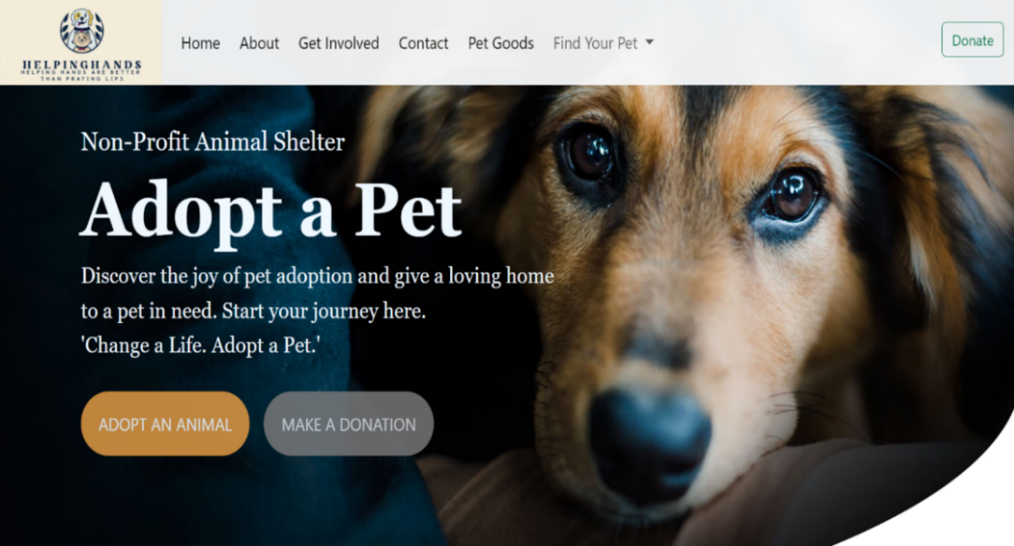
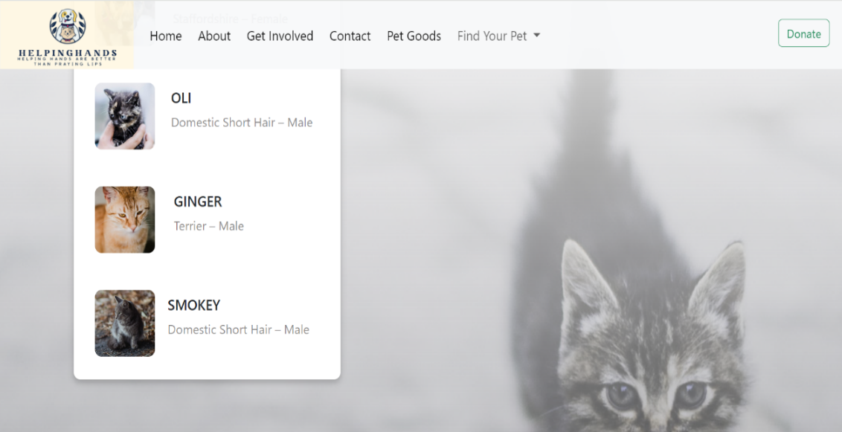
Results
HOME PAGE

Slide 10
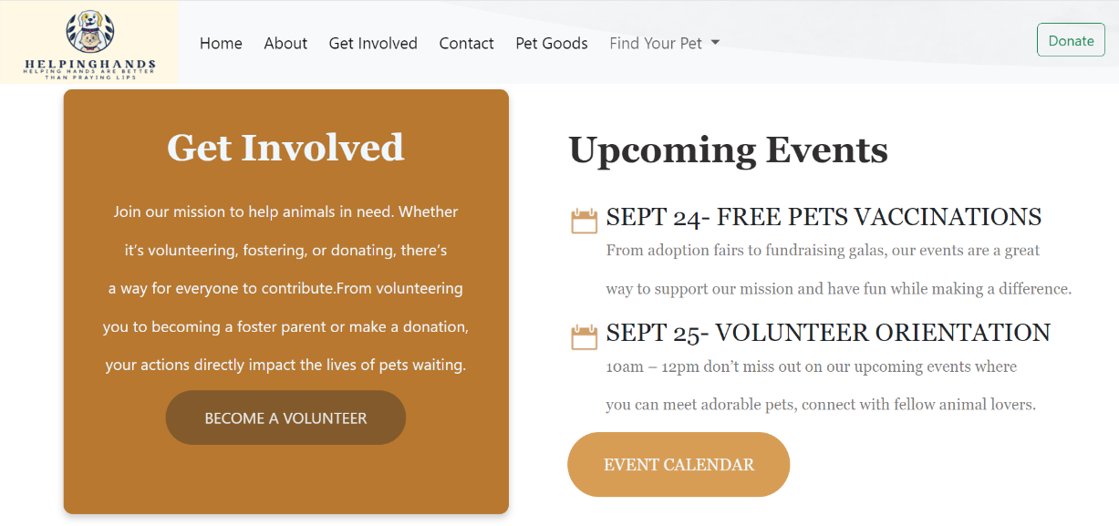
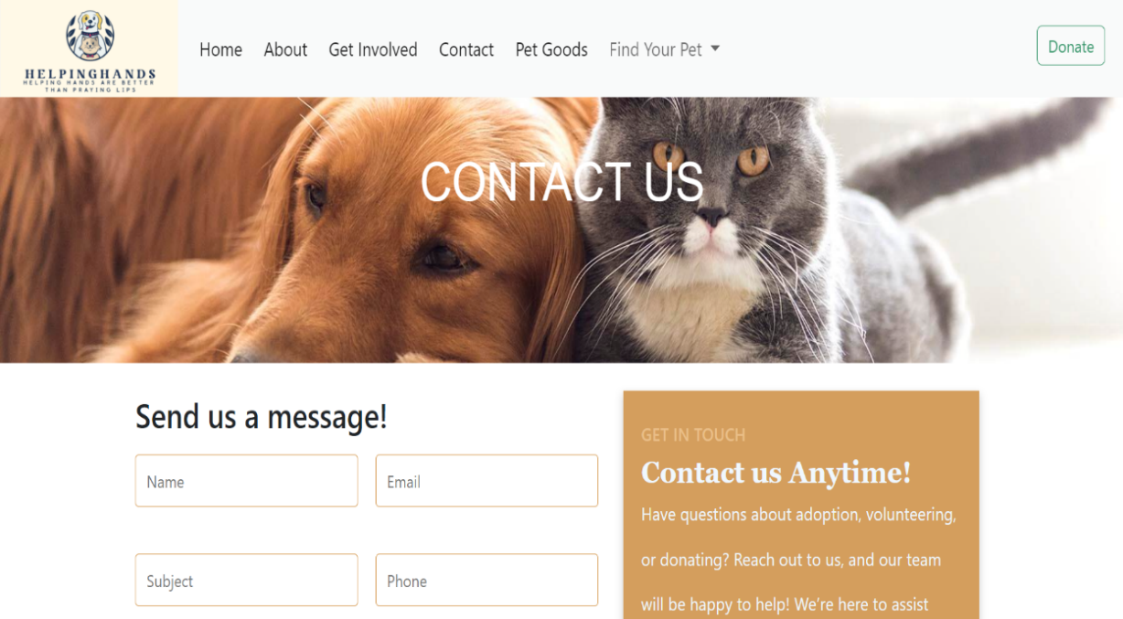
Get Involved PAGE
Contact us PAGE

Slide 11
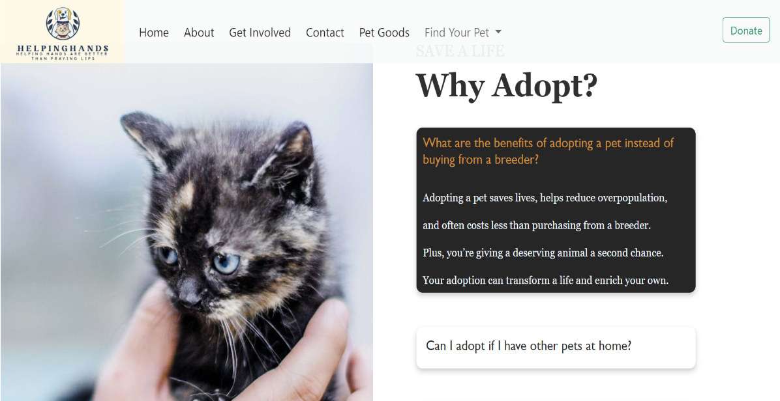
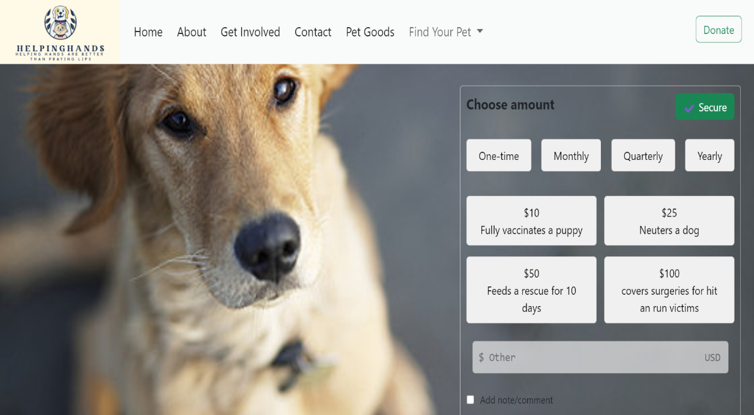
Contact Us PAGE
Donate PAGE

Slide 12
Conclusion
HelpingHands is designed to revolutionize the way animal shelters operate and engage with the community. By integrating a range of key features such as:-
Detailed pet profiles
Streamlined adoption process
Secure donation systems
Online store
HelpingHands addresses the common challenges faced by shelters and enhances their ability to connect with potential adopters and supporters.

Slide 13
Future Plans
Foster Community Engagement: Build a supportive online community around animal welfare through forums, social media.
Donor Information: Names, contact details, and donation amounts, records of all donations, campaigns, and funding sources
Adoption Process: Step-by-step guide, FAQs, and online application form.
User Accounts and Profiles: Allow users to create accounts for a personalized experience and can manage their profiles and many more.
The AI-powered pet matchmaking: Feature which I plan to implement or evaluate in future phases, aims to introduce a unique and innovative element to the platform.
JavaScript: It is intend to incorporate JavaScript into our website to enhance user experience and interactivity.
React: Aim to build a more dynamic and responsive interface, allowing for seamless updates and faster load times.

Slide 14
References/Links used
Name of website​ | Hyperlink​ | Founder | Year​
Dog Sanctuary | Adopt | Territorio De Zaguates | Lya Battle and Alvaro Saumet | April, 2007
Petfinder | https://www.petfinder.com/ | Betsy Banks Saul and Jared Saul | May, 1996 ​
Zigly | https://www.zigly.com/?gad_source=1&gclid=EAIaIQobChMIh_D2svjHhwMVwBGDAx2dWRRaEAAYASAAEgJ_L_D_BwE | Ashok Jaipuria | Sept, 1981​

Slide 15


